Slide 1

Village of Dexter
Resident’s ZoningToolkit
enter

Slide 2
The Village of Dexter, Resident’s Zoning Toolkit
is produced by the
Planning Board of the Village of Dexter
for the convenient access of residents
to the key requirements of our zoning law
Click here for menu
IMPORTANT: This guide to the Village of Dexter Zoning Law
is produced for informational purposes only and is not intended
to supersede or to replace the Village of Dexter Zoning Law.

Slide 3


Zoning Districts
Solar Collectors
Fencing
Wind Turbines
Off-Street Parking
Zoning/Building Permit
Special Use Permits
Signs
Mobile Homes
Home Occupation
Next Menu

Slide 4


General Questions
about Zoning
Travel Trailer/
Recreational Vehicles
Off-Street Loading
Subdivision
Temporary uses
and Structures
Outdoor Solid
Fuel Furnaces
Adult Uses
Nonconformities
Waterfront Lots
Back to the first menu

Slide 5
Zoning Districts:
RESIDENTIAL
There are three types of residential zoning:
R1: single-family; R2: one to two-family
R3: Multifamily Residential
COMMERCIAL
C1 is the Commercial Zone
LIGHT INDUSTRIAL
L1 is the Light Industrial Zone
Zoning Map
The Village of Dexter Zoning Map
Reference: Article III; 325-7 to 325-15
menu

Slide 6
RESIDENTIAL ZONING : R1,R2,R3,R4
R1
Single-Family Residential
R2
Single and Two-Family Residential
R3
Multifamily Residential
R4
Single and Two-Family Residential
Reference: Article III; 325-7 to 325-10
Return to menu

Slide 7

R1
Single-Family Residential
Minimum Lot Area:
8,000 square feet
Minimum rear
Yard setback
30 feet
When two rear yards
meet, each owner’s
building must set
back 15 feet from
the rear property
line.
House: 35% maximum
Lot coverage
10’
Minimum side
yard setback
Accessory use
or structure
will have a
minimum
5 foot
setback
5’
.
25 feet
minimum front yard setback
Or in-line with main structure,
or neighboring adjacent buildings
65 feet
ref: 325-7
Minimum lot width measured at frontage

Slide 8

R2
Single and Two-Family Residential
PLEASE CHOOSE YOUR SITUATION :
Single Family Dwelling, Residential Conversion
Two Family Dwellings
325-8

Slide 9

R2
Single and Two-Family Residential
Residential Conversions
When two rear yards
meet, each owner’s
building must set
back 15 feet from
the rear property
line.
Minimum rear
Yard setback
30 feet
Minimum Lot Area:
8,000 sq. ft.
Minimum dwelling
unit size: 550 sq. ft.
Maximum Lot
Coverage by house
35%
10’
Minimum side
yard setback
Accessory use
or structure
will have a
minimum
5 foot
setback
5’
.
25 feet front yard setback
Or in-line with main structure,
or neighboring adjacent buildings
65 feet
Minimum lot width measured at frontage
325-9 p.325:20

Slide 10
R2
Single and Two-Family Residential
Two-Family Dwellings
When two rear yards
meet, each owner’s
building must set
back 15 feet from
the rear property
line.
Minimum rear
Yard setback
30 feet
Minimum Lot Area:
10,000 sq. ft.
Minimum dwelling
unit size: 550 sq. ft.
Maximum Lot
Coverage by house
35%
10’
Minimum side
yard setback
Accessory use
or structure
will have a
minimum
5 foot
setback
5’
.
25 feet front yard setback
Or in-line with main structure,
or neighboring adjacent buildings
80 feet
Minimum lot width measured at frontage
325-8 p.325:19

Slide 11
R3
Single and Two-Family Residential
Multiple-Family Dwellings
When two rear yards
meet, each owner’s
building must set
back 15 feet from
the rear property
line.
Minimum rear
Yard setback
30 feet
Minimum Lot Area:
12,000 sq. ft.
Minimum dwelling
unit size:
3,000 sq. ft.
Maximum Lot
Coverage by house
35%
10’
Minimum side
yard setback
Accessory use
or structure
will have a
minimum
5 foot
setback
5’
.
25 feet front yard setback
Or in-line with main structure,
or neighboring adjacent buildings
100 feet
Minimum lot width measured at frontage
325-8 p.325:19

Slide 12
R4
Single and Two-Family Residential
When two rear yards
meet, each owner’s
building must set
back 15 feet from
the rear property
line.
Minimum rear
Yard setback
30 feet
Minimum Lot Area:
16,000 sq. ft.
Maximum building
height: 35 feet
Minimum
dwelling size:
1,100 sq. ft.
10’
Minimum side
yard setback
Maximum Lot
Coverage by house
35%
Accessory use
or structure
will have a
minimum
5 foot
setback
5’
.
25 feet front yard setback
Or in-line with main structure,
or neighboring adjacent buildings
80 feet
Minimum lot width measured at frontage
325-8 p.325:19

Slide 13
C
Commercial
Minimum Lot Area:
12,000 sq. ft.
Maximum
stories: 3
MaximumHeight:
35 feet
Minimum rear
Yard setback
30 feet
35% maximum
Lot coverage
10’
All permitted Uses (click) require a
Special Use Permit
Minimum side
yard setback
Accessory use
or structure
will have a
Maximum
24 feet
height
.
30 feet
As measured from the front
Building line.
100 feet
325-11 p.325: 23
Minimum lot width measured at frontage

Slide 14
L-I
Light Industrial
Requires special use
Permit
Minimum Lot Area:
0.5 acre
Maximum
stories: 3
Minimum rear
Yard setback
30 feet
35% maximum
Lot coverage
10’
Minimum setback
50 feet from any
residential lot
Minimum side
yard setback
.
25 feet
As measured from the front
Building line.
100 feet
325-12 p.325: 24.1
Minimum lot width measured at frontage

Slide 15


SMALL WIND SYSTEMS
menu
General Guide
for use in Planning
your Small wind system.
Village requirements for the safe siting
and installation of small wind systems
Are found in the Village of Dexter Zoning Code at section: 325-39.2
IMPORTANT: All small wind systems
Require a special use permit
Commercial wind turbines are excluded
From the Village of Dexter

Slide 16



Tower-Mounted Wind Turbine:
Where you can put-up a tower:
The minimum distance between the ground and any part of the rotor or blade system shall be
30 feet.
Setback Example: If your Tower is 100 feet high,
Your setback in every direction is at least 150 ft .
Setbacks from all property lines shall be maintained, at a minimum, at 1 ½ times the height of the tower
(as measured from the furthest extension of the wind-rotor blade).
No part may be located within or over drainage, utility or other established
Easements or on or over property lines.

Slide 17



next
Must cause no
stray voltage
Or electromagnetic interference
Exterior lighting
On the structure
Is not allowed, except
as FAA-required
A small wind turbine should,
to the greatest extent, use natural
landforms and vegetation for
Screening.

Slide 18

Noise level must not be more than ambient + 5 decibels measured at the nearest property line.
Anchor points shall be located on
The same property and will not cross
Above-ground electric or distribution
Lines.
Point of attachment
sheathed In bright
orange or bright yellow.
Electrical wires installed underground
Except for tie-ins to utility Company
Turbine tower and blades shall be
Painted in a non-reflective non-obtrusive color
To blend in as much as possible.
back
next

Slide 19

General Technical requirements:
All small wind turbines shall be designed and constructed to be compliant with pertinent provisions of the:
Uniform Building Code,
National Electric Code and
Village of Dexter Zoning Code /
Zoning Law
All systems will be equipped with
manual and automatic
over-speed controls
Manufacturer’s logos will be
Unobtrusive.
Click here to read the Special Use Permit requirements for Small Wind systems
back
menu

Slide 20
Additional Special Use Permit requirements for Small Wind systems:
Provide: make, model and manufacturer’s specifications of proposed system,
including sound power level data, materiel safety data sheets for all materiel used
in the operation of the equipment.
Location of each tower and accessory facility or equipment.
Ownership and land use information for all parcels within 500 feet of the location
of the tower or roof-mounted system.
4. Unless the owner does not plan to tie into the grid, written notice from
the applicable utility company confirming the applicant’s proposed intent.
A visual analysis of the proposed installation. This may consist of drawings
from different strategic vantage points, photos, computer rendering, or
whatever will assist the Planning Board. The visual analysis will also address
the color treatment of the system’s components and any visual screening
incorporated into the project to lessen the system’s visual prominence.
(summary: we need to know what the system is actually going to look like)
Reference: Article IV; 325-39.2
back

Slide 21
Special Use Permits begin with
A Building Permit:
back
In order to get a Special Use Permit you must go to the Village and first pick up
a Building Permit (shown below). The Code Enforcement Officer will then assess
the project and determine whether or not it needs to be referred to the Planning
Board for approval. The Planning Board will then schedule a meeting and review
your project for Approval. The best way to get your project underway is to have
the form filled-out properly along with whatever enclosures might be required.
The Planning will review your request at the next scheduled meeting once a
completed form has been submitted along with all required enclosures.
If you are uncertain about any of the details on the form or have substantial
Questions you can ask for a pre-submission conference
If you want the Planning Board to do a review of your planned submission.
Building Permit
Form.
Top half of form
Building Permit
Form.
Middle section
Building Permit
Form.
Bottom of form
Building Permit
Form, whole form

Slide 22
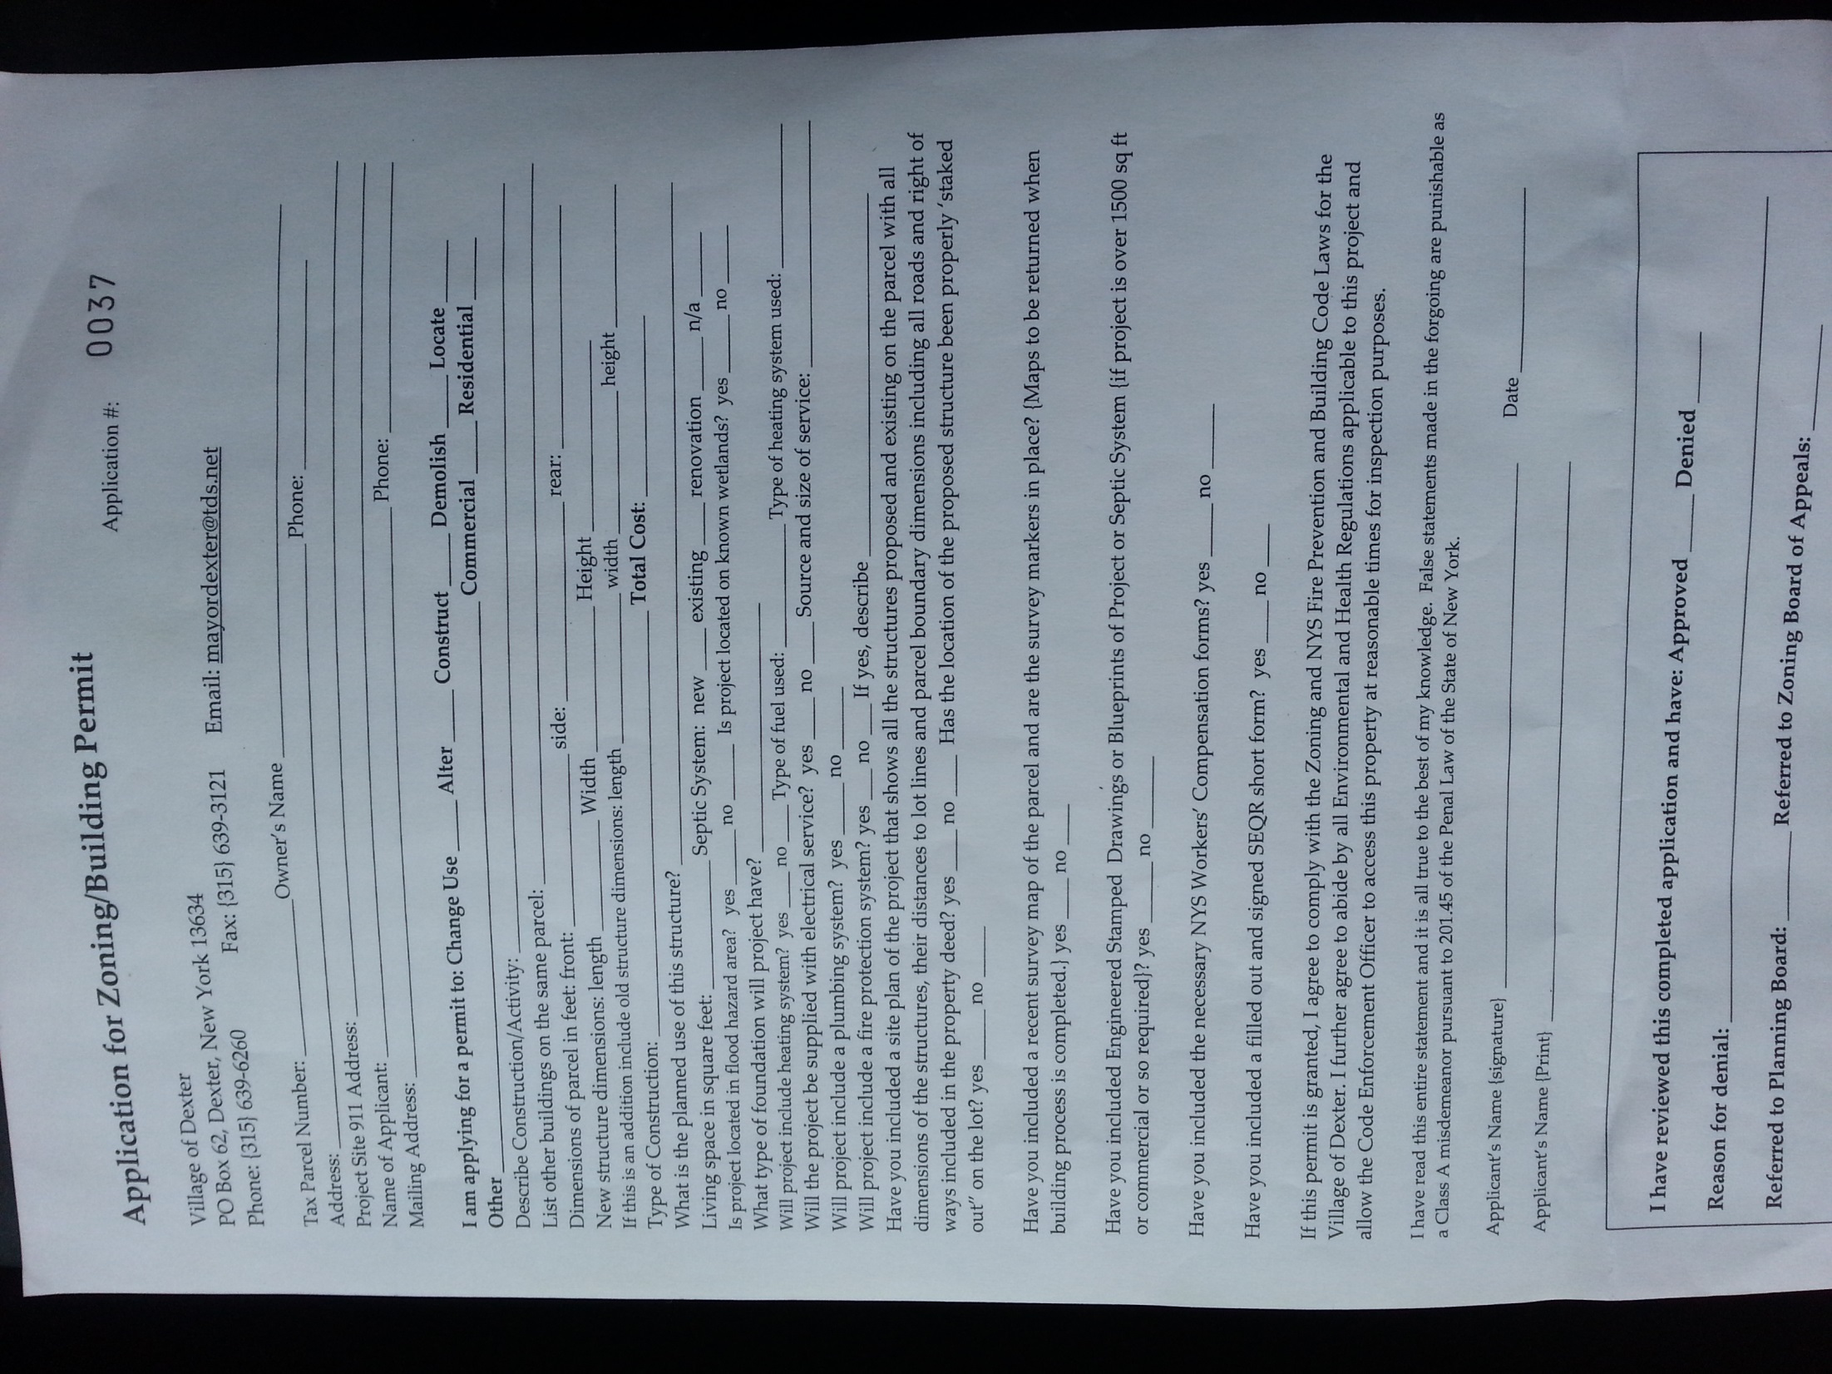

Slide 23
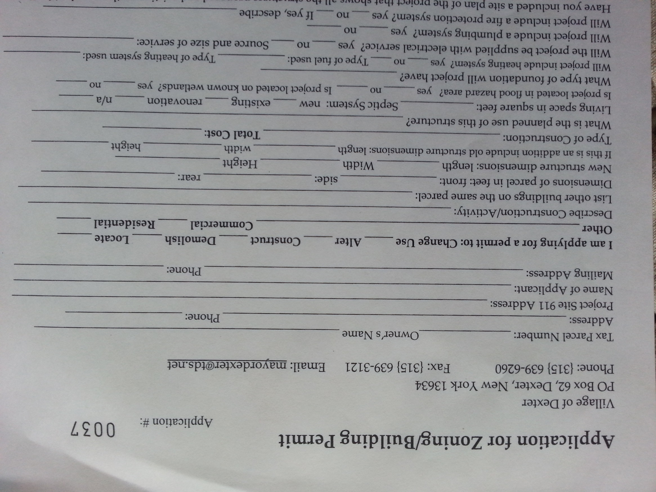

Slide 24
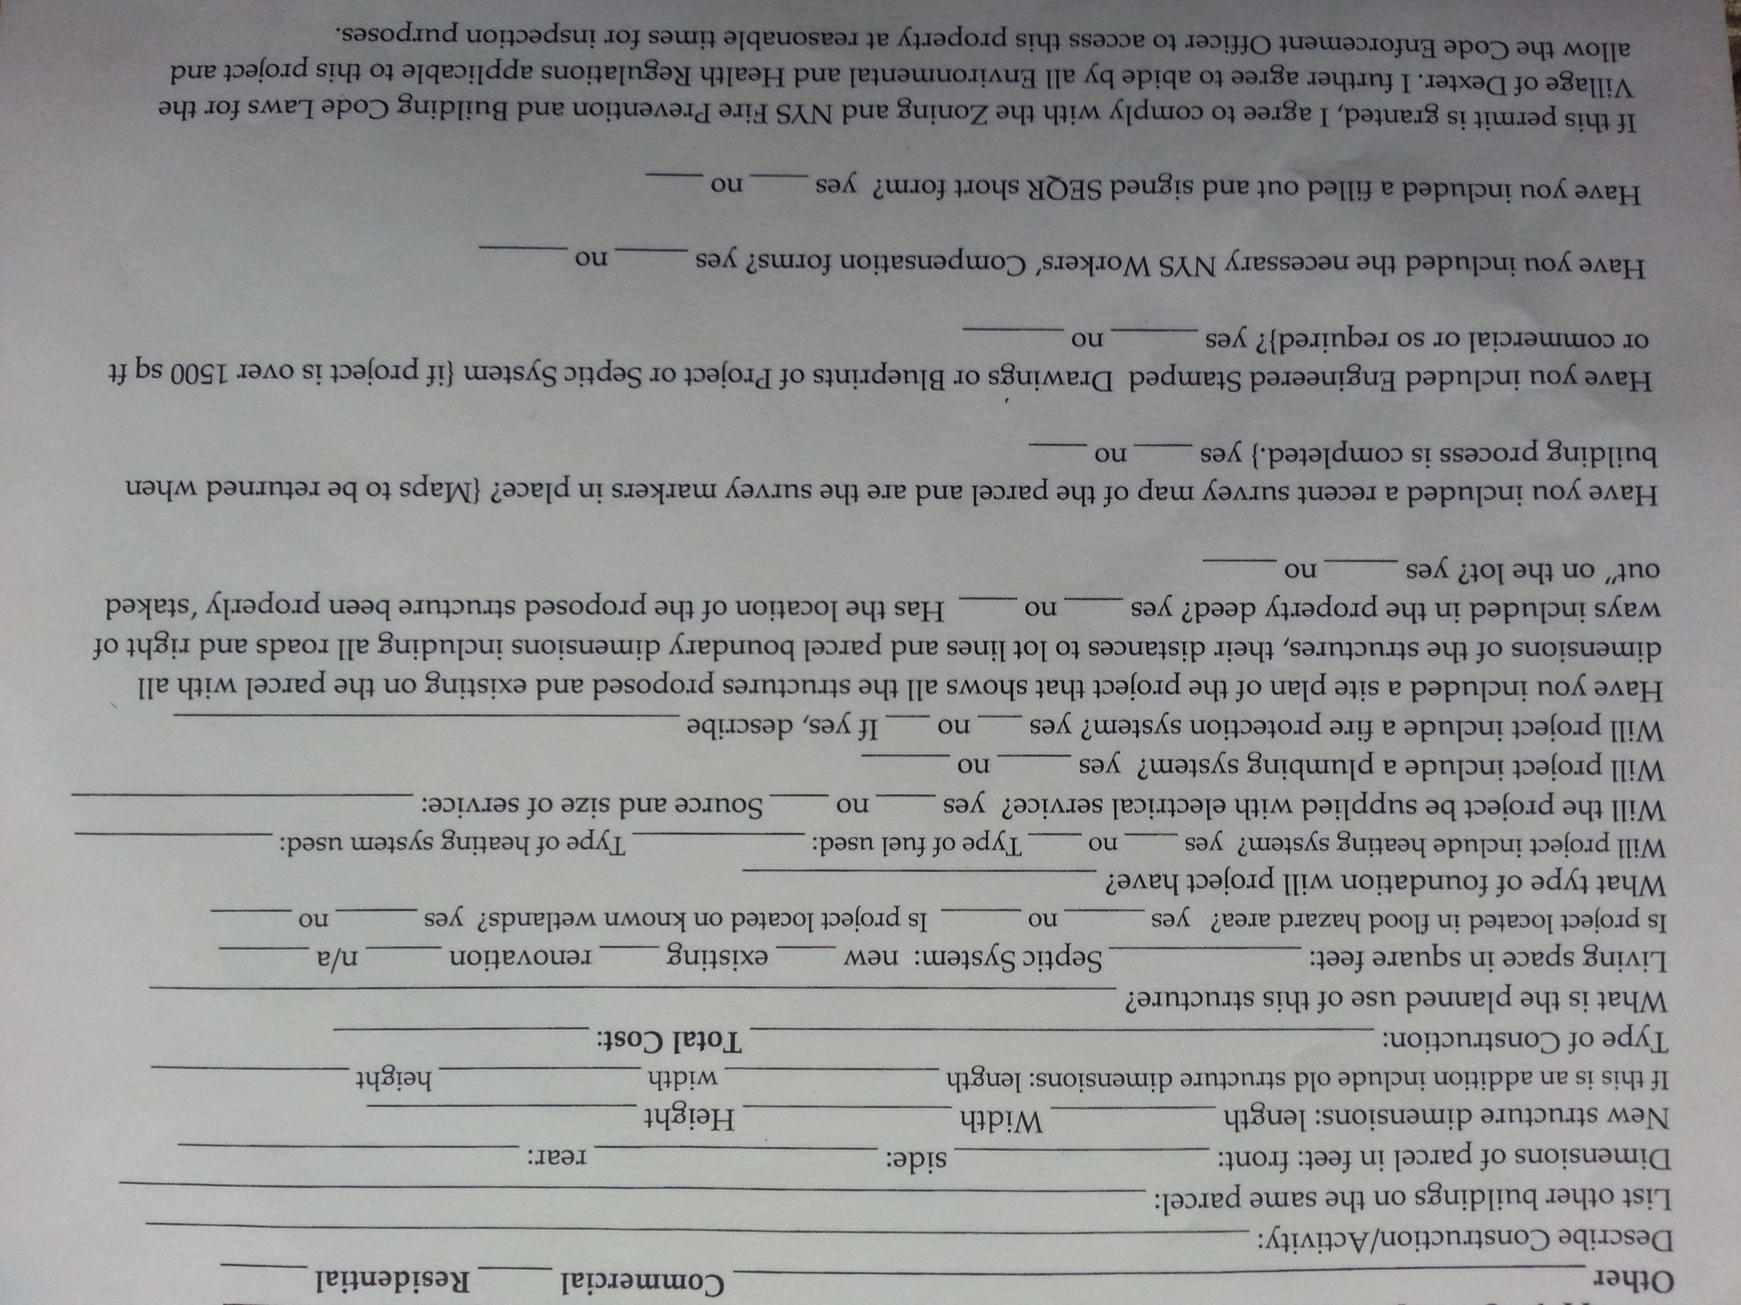

Slide 25
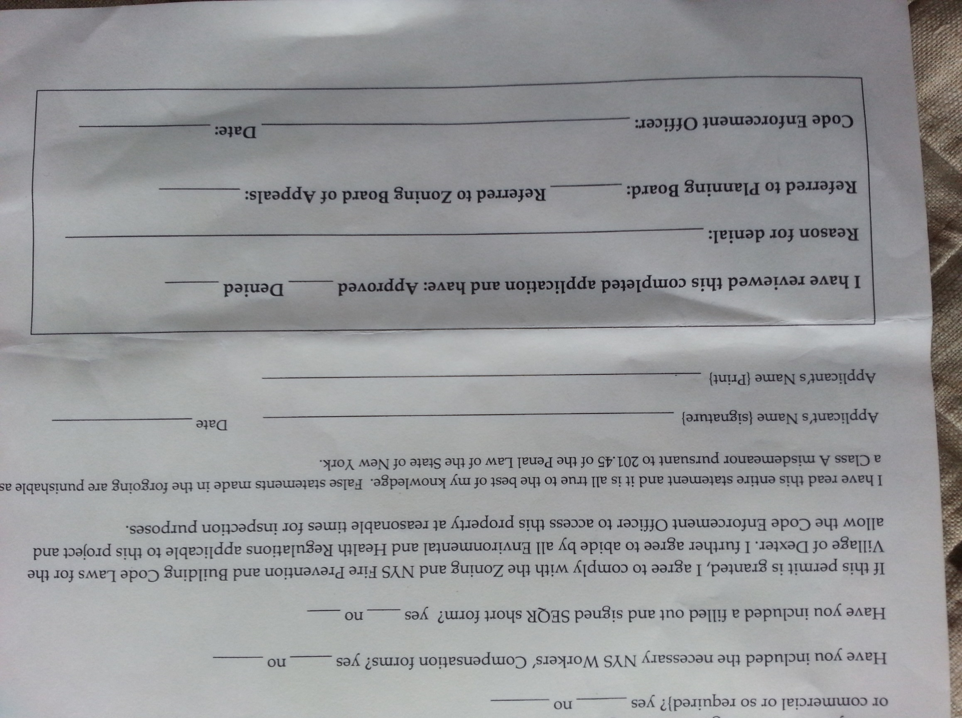

Slide 26

Solar Collectors
GENERAL INFORMATION:
A Special Use Permit is required.
Systems are permitted only to provide power for use by owners/occupants.
Rooftop and building-mounted systems are permitted and require building permits.
Ground-mounted and free-standing solar collectors are permitted as accessory structures in all zoning
Districts, subject to the siting requirements on the next page
Click here for information about the
Site plan review, Plan to be submitted to Building/Code Inspector, electrical connections, battery information, abandonment of /non-functioning system.
Next
Reference: Article IV; 325-39.1

Slide 27



Ground-mounted and
Freestanding collectors
Solar
20 feet
Will meet
Setback
Requirement
For applicable
Zoning district
Height of collector
and mounts will not
Exceed 20 feet with
Collector at
Maximum tilt
Solar collectors must be placed in a side or rear yard
Menu
Next

Slide 28
SITE PLAN REQUIREMENTS:
Indicate all existing and proposed: Grading, excavating, filling, paving, Fencing and screening, location of all property lines and neighboring buildings
Prior to operation, the system’s electrical connections must be inspected by the appropriate inspection agency. Any connections
To the public grid must be inspected by the appropriate public utility. The Code Inspector will notify the local fire department of the installation.
If the system includes batteries,
they must be used and stored and disposed
Of in accordance with New York State
Building Code and other applicable laws.
If a system is not functional after 12 consecutive months
the owner has 90 days to remove the system, mount and
associated equipment.
back
menu

Slide 29


SIGNS
Any Residential district:
One customary professional sign
no larger than 4 feet square
Real-estate signs no larger than 8 sq. ft.
on properties for sale or rent.
other signs appropriate to public or
semipublic buildings safety/welfare
or as mandated by law
PIZZA
General restrictions:
Signs will not extend over sidewalks or other public ways
Signs will not be illuminated with flashing, intermittent, rotating or moving
Lights except to show time and temperature.
Any sign in a state right-of-way or trail should have prior state approval.
Commercial Zone business signs larger than 40 square feet require a zoning permit.
Signs in commercial and industrial districts are subject to
A special use permit.
menu
next
Reference: Article III; 325-20

Slide 30
Signs in a Commercial District
Sign must be advertising a business conducted on the premises.
Requires a zoning permit.
No place of business in the
commercial district shall make
Exterior displays of more than
three signs of any size.
40 Square Feet
The area of a sign does not include the supports or uprights
But will include the frame and everything included in the display.
back
menu

Slide 31
parking
All uses in the village will have off-street parking
Requirements may be modified by special use permit
10
X
18
Minimum size of a parking space is 10 ft. x 18 ft.
not counting the access ways and the driveway.
Residential: single-family: 2 spaces per dwelling unit
multifamily: 1 ½ spaces per dwelling unit (>3 dwelling units)
Places of Assembly: 1 space for every four seats, or 1 parking space for every
200 square feet of gross floor area, whichever is greater.
Restaurant/eating and drinking establishments: 1 parking space for every
60 square feet of gross floor area.
Hotel, motel, tourist home, boarding house: 1 space for each guest room
Reference: Article III; 325-18
menu
next

Slide 32
Parking continued
Mortuary: 1 space per 100 ft of gross floor space
Light Industrial: 1 per employee at maximum working shift
Retail, small product: 1 per each 200 square feet of gross floor space
Retail, large products: 1 per each 400 square feet of gross floor space.
Wholesale establishments or warehouses: 1 per each employee at maximum shift.
Office, general: 1 per each 200 square feet of first floor area plus 1 per each
300 square feet above the first floor, plus 1 per each employee.
Unspecified Uses: As required by the Planning Board
menu
back

Slide 33
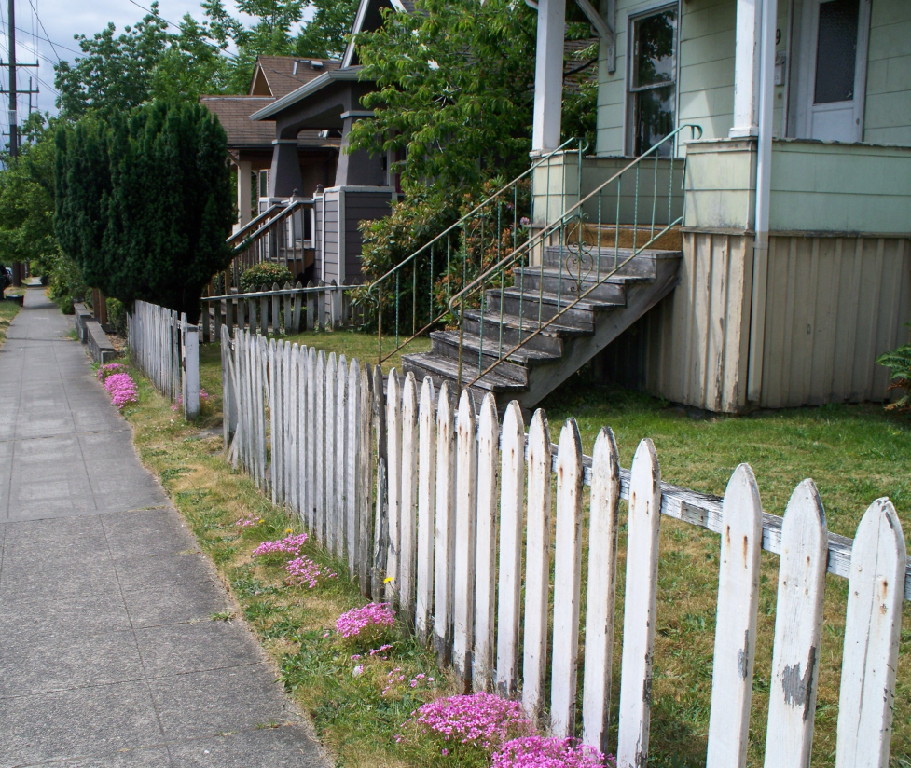

Fences and Walls
Permit required
Allowed in all zones
Walls are not addressed in the village law, other than being restricted to 6 feet
(except around a swimming area) and 3.5 feet in corner lots in restricted zone.
Chained link fence must have closed loops on top
Not more than 6 feet high
unless enclosing a swimming pool
2 feet from
property line
finished side facing
out and posts inside
No barbed-wire or razor wire type fences
menu
Corner Lot Restrictions
Reference: Article III; 325-33

Slide 34


Corner Lots
3½ feet height limit
On shrubbery
In this area
And traffic safety
No Structures, fences, signs, shrubbery over 3 ½ feet
ROAD
40 feet
ROAD
For the purpose of traffic safety, corner lots must keep shrubbery, signs and other
obstructions at or below 3.5 feet in height in a triangular zone formed by lines along the
Village right-of-way to points 40 feet back and then connecting those lines forming
A triangle as shown above.
back

Slide 35
Home Occupation
General requirements:
Be carried out by the home occupant(s) on site, as a profession.
One employee is permitted
Occupation takes up no more than 25% of the dwelling unit
If the occupant is not the owner, the occupant will have written
permission from the owner to occupy not more than 25% of the space.
Must not produce objectionable odors, noise or unsightly conditions
Must be clearly incidental to the residential use of the dwelling
PROHIBITED AS HOME OCCUPATIONS:
Animal hospitals stables or kennels funeral homes
Private clubs restaurants
Unlisted occupation not prohibited, will require a
Special Use Permit from the Planning Board, and
may be granted or denied by the Village Board
menu

Slide 36
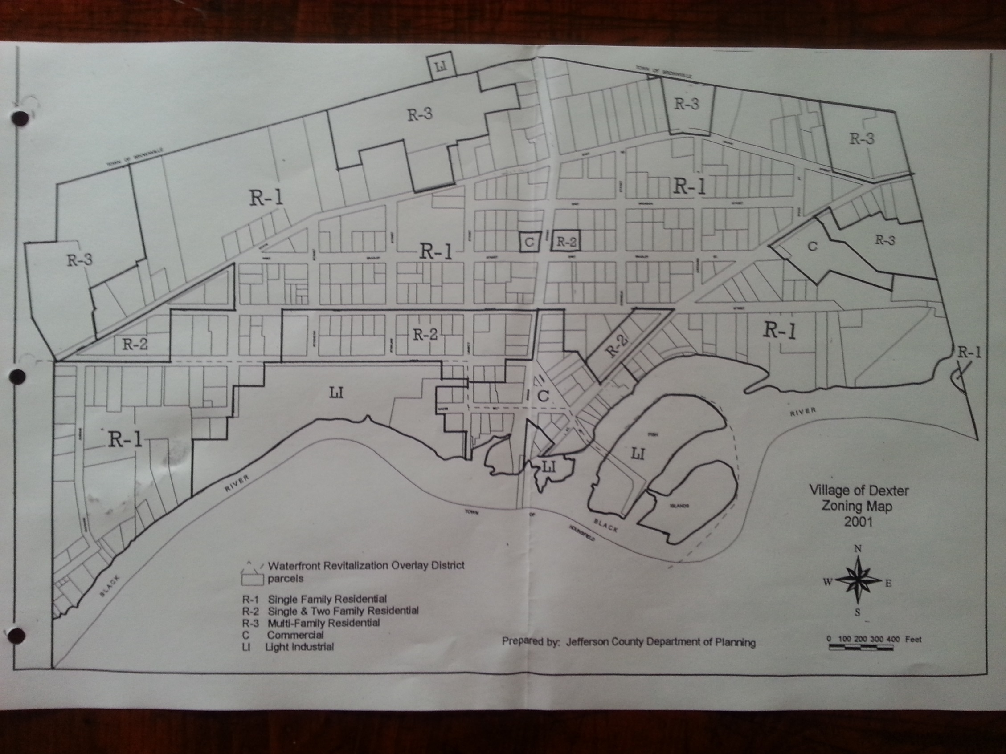
Not shown is the Grant Street subdivision area which is zoned : R4
back
Village of Dexter Zoning Map
menu
next

Slide 37
Mobile Homes
A mobile home is not defined as a dwelling unit in the Village of Dexter.
(Existing) Mobile homes not located in a park shall be subject to all the applicable regulations and setbacks that are required in the zoning district.
Two or more mobile homes placed there for non-transient use under a single
or common ownership constitute a mobile home park.
Mobile Home Parks are permitted in the Village of Dexter in the L-1 Zones only. Mobile Home Parks require a Special Use Permit
Applications for Mobile Home Parks require additional information and
requirements and this list Is available at 325-21C and D
Mobile home sales areas may be permitted in the Commercial
and Light Industrial Zones with a Special Use Permit and approval
of the Planning Board.
Reference: Article III; 325-21 and 24
menu

Slide 38
Adult Uses
Adult Entertainment Establishments are permitted within the L-1
Zoning District (Light Industrial) and are governed by additional
Requirements and specific standards. Please reference the Zoning Law at:
Article III; 325-39 for more details.
Basic restrictions for adult uses:
In L-1 Light Industrial Zone only
Prohibited within 500 feet of a residential zone or municipal boundary
Prohibited within 1000 feet of any church, school, park, library or playing field
Prohibited within 50 feet from any other business use
Prohibited within 200 feet from any other adult use.
Reference: Article III; 325-39
menu

Slide 39

Solid Fuel Outdoor Furnaces
The construction, installation or operation of outdoor solid-fuel furnaces
whether as a new or replacement installation, is prohibited within the
Village of Dexter.
Reference: Article III; 325-36
menu

Slide 40
Subdivision
Village of Dexter Subdivision Law: Chapter 625
Whether you are dividing a piece of property (subdivision) or putting two pieces
of property together (assemblage or consolidation) the Subdivision Law of the Village of Dexter outlines what you will need to know about application/approval procedures, design standards or required improvements, authorizations, permits, fees and variances.
The Village of Dexter Board of Trustees requires that the Village of Dexter Planning Board review, approve, Conditionally approve with or without modification, or disapprove subdivision plats showing lots, blocks or sites with or without streets, within the Village.
So if you are putting together two or more parcels of land or have decided to subdivide your land, you will need to be familiar with the requirements of this law. The Planning Board stands ready to assist village residents with this process and residents may request a review from the Planning Board before the submission of a formal application, fee, or filing with the Planning Board.
625
menu

Slide 41
Temporary Uses And Structures
Temporary structures which are otherwise non-conforming
could include a fruit/vegetable stand, a temporary real estate office
Connected to a subdivision, a temporary structure related to an ongoing
construction project and so on. A temporary permit for such structures
may be issued by the Zoning Enforcement Officer for a period not to
exceed one year.
menu
Reference: Article III; 325-38

Slide 42
Off-Street Loading
Every building occupied for the purpose of commercial or
Industrial use shall provide adequate space for loading and
unloading vehicles off the street.
Reference: Article III; 325-7 to 325-15
menu

Slide 43
Travel Trailer
and Recreational Vehicles
If the trailer is not in a village-approved trailer park, then
A single travel trailer may be occupied on private land with
The consent of the owner, for a period no longer than 30
Consecutive days, as long as sanitary services are available.
People can park their unoccupied campers, trailers or other
Recreational vehicles on their lots for the purpose of storage.
Reference: Article III; 325-23
menu

Slide 44

Waterfront Lots
Waterfront construction, as well as the Village Waterfront Overlay District
Must adhere to the following two chapters of the Code of the Village of Dexter:
Chapter 314, The Waterfront Consistency Review
Chapter 102, Flood Damage Prevention
Residents with waterfront lots should check with the village zoning officer to
Determine if there are any additional issues which must be considered.
325-25

Slide 45
Nonconformities
Many uses, lots of record or structures which legally existed at the time of the enactment of this law would be prohibited or unreasonably restricted by the enactment of this law. Those elements are “grandfathered-in”.
The Key Idea behind this chapter of the zoning law is this: whether it is a
nonconforming uses, lot or structure, any changes contemplated must not
increase the nonconformity. Once changed to be conforming a nonconforming
situation may not revert back to being nonconforming. It is only the nonconformity which is restricted.
ONE YEAR
A nonconforming use of land or of a structure which, for whatever reason,
has been discontinued for a year, will not be allowed to revert back to its previous
Nonconformity.

Slide 46


GENERAL QUESTIONS ABOUT ZONING
(Click on the arrow to go to the answer)
What is ‘zoning’ ?
Why do we have a zoning law?
Who writes the Zoning Law?
What is the zoning law based upon?
What is the Planning Board?
What is the Zoning Board of Appeals?
Why do I need to come to the Village Office to get a Building Permit?
Why would I need a Special Use Permit, and how do I get one?
What is a Code Enforcement Officer/Zoning Officer?

Slide 47
PERMITTED USES: COMMERCIAL DISTRICT C1
USES PERMITTED UPON SPECIAL USE PERMIT APPROVAL:
Large and small product retail use
Offices
Marina
Restaurant
Automobile service station
Public and private parking garages and lots
Hotels, motels
Funeral home
Rental operations
club, shopping center, theatre
Public and semi-public facilities
Professional offices
Personal services
Accessory uses
Fraternity and sorority
Solar collectors, small wind turbines
Similar commercial uses to the above listed uses

Slide 48
PERMITTED USES: COMMERCIAL DISTRICT C1
USES PERMITTED UPON SPECIAL USE PERMIT APPROVAL:
Large and small product retail use
Offices
Marina
Restaurant
Automobile service station
Public and private parking garages and lots
Hotels, motels
Funeral home
Rental operations
club, shopping center, theatre
Public and semi-public facilities
Professional offices
Personal services
Accessory uses
Fraternity and sorority
Solar collectors, small wind turbines
Similar commercial uses to the above listed uses

Slide 49
PERMITTED USES: LIGHT INDUSTRIAL L1
The following allowed uses require a special use permit:
Manufacturing plants, light industrial operations
Public utility facility, telecommunications facility, medical center
Wholesale establishments and warehouses, mobile home park
Body shop, recreational facilities, adult uses,
Offices, Marina, Restaurant, Automobile service station
Public and private parking garages and lots
Hotels, motels, Funeral home, Rental operations
club, shopping center, theatre, 50-persons max restaurant, agriculture
Public and semi-public facilities
Professional offices, Personal services
Accessory uses
Fraternity and sorority
Solar collectors, small wind turbines
Similar commercial uses to the above listed uses

Slide 50
PERMITTED USES: Multifamily Residential R3
USES PERMITTED UPON SPECIAL USE PERMIT APPROVAL:
PERMITTED USES:
Single-family dwellings, modular and single-/double-wide mobile homes
Two-family dwelling
Residential conversions: maximum of two dwellings
PERMITTED USES UPON SPECIAL PERMIT APPROVAL:
Multifamily dwelling, apartments, condominium
Public and semi-public facilities, funeral homes
Home occupations, bed-and-breakfasts, tourist homes
Essential services
Solar collectors, small wind turbines
Accessory use/structure to the above listed uses

Slide 51
PERMITTED USES: Single/Two Family Residential R2/R4
USES PERMITTED UPON SPECIAL USE PERMIT APPROVAL:
PERMITTED USES:
Single-family dwelling
Two-family dwelling
PERMITTED USES UPON SPECIAL PERMIT APPROVAL:
Townhouses
Public and semi-public facilities
Home occupations
Essential services
Solar collectors, small wind turbines
Accessory uses to the above listed uses

Slide 52
PERMITTED USES: Single Family Residential R1
USES PERMITTED UPON SPECIAL USE PERMIT APPROVAL:
PERMITTED USES:
Single-family dwelling
PERMITTED USES UPON SPECIAL PERMIT APPROVAL:
Public and semi-public facilities
Home occupations
Essential services
Solar collectors, small wind turbines
Accessory uses to the above listed uses

Slide 53
--------------------------------------
What is Zoning?
The word ‘zoning’ refers to the various zones depicted on the Zoning Map
Of the Village of Dexter. The Board of Trustees of the Village of Dexter in
years past approved as a part of the local law, a zoning map depicting the
various desired land uses. There are four kinds of residential zones (R1-4)
One zone is for light industrial use (L1) and another zone is for commercial
Use (C1).
Why do we have zoning?
To protect the character and the values of residential, commercial , industrial
and public uses; to ensure their orderly and beneficial development.
To provide enough light, air and space and to prevent overcrowding of the land.
To regulate the location of buildings and the intensity of land use
To facilitate the providing of public services
To guide the development of the village according to Dexter’s
Comprehensive Plan. Under the current law, the Planning Board is charged
with developing the Comprehensive Plan.
next

Slide 54

Who writes the zoning law and what is it based upon?
The zoning law is a combined effort of many people including the Planning Board
and the Village of Dexter Board of Trustees who pass it into law after legal review.
The Zoning Law is based upon a document called the: Village of Dexter
Comprehensive Plan. This plan is the result of a village consensus as to what
Residents would like their village to look like, what elements residents would
like to change and elements residents would very much like to preserve.
What does the Code Enforcement/Zoning Officer do?
The village hires the services of a Zoning Officer in order to enforce the Village
Zoning Law. When necessary, the Zoning Officer will deny a request for a permit
Because the project cannot be accomplished under the current zoning law.
Residents who have been denied by the zoning officer may seek a review by
appealing their situation to the village Zoning Board of Appeals. This is a board
appointed by the Mayor/Trustees and staffed by volunteers. The Zoning Officer
May refer an application to the Planning Board.

Slide 55
The Planning Board of the Village of Dexter is charged with authorizing
Site Plans, Special Use Permits, and Subdivisions. The Planning Board also
Is charged with developing and updating the Comprehensive Plan for the
village. The Planning Board is appointed by the Mayor/Trustees and is
Composed of unpaid volunteers who must be residents of the village.

